Slide 1
Parkinson’s disease: The basics
Praveen Dayalu, MD
Clinical Associate Professor
Department of Neurology
University of Michigan

Slide 2
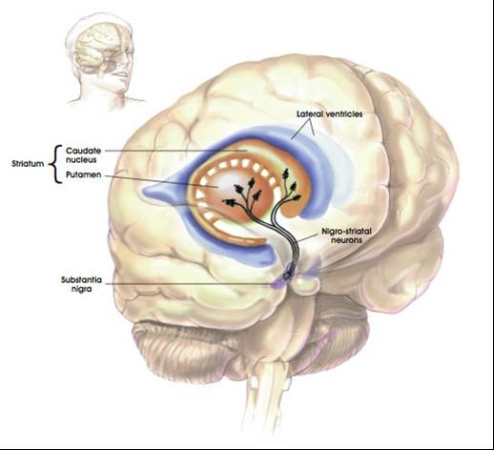
The basal ganglia

Slide 3
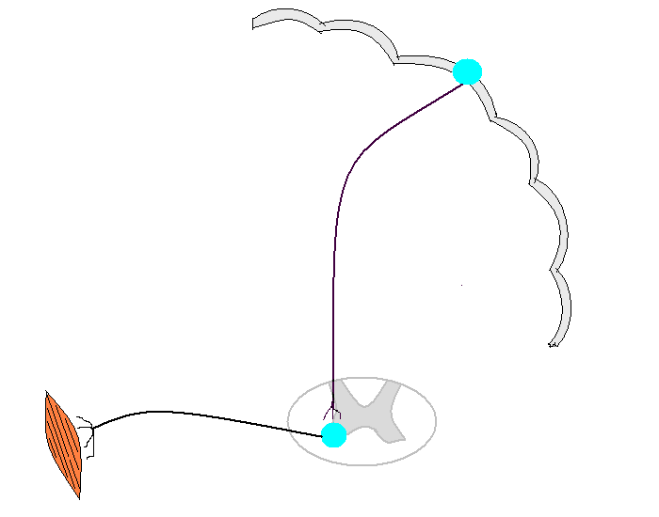
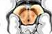
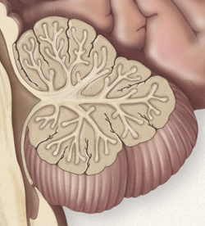
Basal ganglia
Cerebellum

Slide 4
Parkinsonism comprises four cardinal motor features
Bradykinesia (slow and small movements). Reduced blink, face expression, and gesturing. Soft voice. Difficulty getting out of chair, shuffling steps, reduced arm swing, freezing
Tremor (usually resting) “pill rolling”, often involves thumb
Rigidity (different from spasticity)
Postural changes. Imbalance, falls; stooped flexed posture

Slide 5
Differential diagnosis of parkinsonism
Parkinson disease (idiopathic or genetic)
Parkinson-plus degenerations (dementia with Lewy bodies, progressive supranuclear palsy, corticobasal degeneration, multiple system atrophy)
Drug-induced parkinsonism (anti-dopaminergics)
Rare but treatable in young people: Wilson disease and Dopa-responsive dystonia
Other: “vascular” parkinsonism, brain trauma, CNS infection

Slide 6
Drug-Induced Parkinsonism
Drugs that reduce dopamine transmission
Antipsychotics / antiemetics: Risperidone, haloperidol, metoclopramide, promethazine, prochlorperazine, etc.
Can be indistinguishable from PD
Clozapine does not seem to cause it; quetiapine appears to have low rates
Management: reduce or discontinue offending agent. Can take months to resolve!

Slide 7
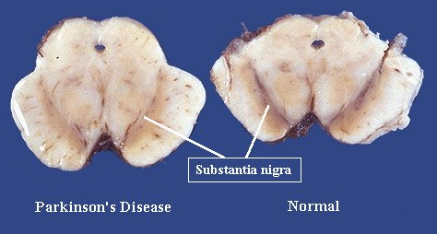
Parkinson Disease (PD)
Usually idiopathic
Substantia nigra degeneration causes dopamine deficiency in striatum → motor symptoms
Dopaminergic therapy relieves motor symptoms
Notes:
L-dopa is the diagnostic test

Slide 8
Parkinson disease: Common early complaints
Resting tremor
Writing smaller; harder to do buttons
Slowness, “weakness”, limb not working well
Stiff or achy limb
Stoop, shuffle-walk, “dragging” leg(s)
Trouble getting out of chairs or turning in bed
Low or soft voice
Non-motor: anosmia, dream enactment, constipation, anxiety, depression, “passiveness”
Notes:
asymmetry

Slide 9
PD: meds for motor symptoms
L-dopa (with carbidopa) is most effective and usually best tolerated
Dopamine agonists (ropinirole, pramipexole)
Others have only modest benefits (MAO-B inhibitors, anticholinergics, amantadine)

Slide 10
Early PD: When to start meds?
Drugs are symptomatic, not neuroprotective or neurotoxic
Level of patient function is best guide
Response to dopaminergic therapy (especially l-dopa) is the best available “test” for PD
** Remember the value of exercise! **

Slide 11
Which treatment to start?
L-dopa most effective for motor symptoms in general (bradykinesia, tremor, gait changes)
Family physicians can start levodopa !!
Dopamine agonists cause more non-motor side effects, and are best avoided in patients above 70

Slide 12
Treatment pearls in early PD
Fear not L-dopa. “Delaying L-dopa” is of no benefit long-term.
Treat more for symptoms and function, and less for how the patient “looks”.
Generics are fine.
Allow adequate dose and time to work before concluding “failure” or “not PD”.
Resting tremor may be medication refractory in some patients; don’t conclude “not PD”.

Slide 13
Levodopa
Most effective overall for motor symptoms
A fine option for initial therapy of PD
By mid to late disease it is almost always needed
Non-motor side effects include nausea, orthostasis, sleepiness, hallucinations; but not as much as other PD drugs
Motor side effect: dyskinesias
Notes:
Dyskin video

Slide 14
Carbidopa/ levodopa dosing
Commonest preparation is regular 25/100mg.
Try 1 pill PO TID → 1.5 pills TID → 2 pills TID. With meals reduces nausea.
2 weeks between steps to appreciate effect.
No response? At least 900mg/ d to say “not PD”.
Some patients need QID or more frequent dosing (even Q3H in advanced disease).
Typical daily l-dopa dose range: 300mg to 1500mg

Slide 15
Dopamine agonists (ropinirole, pramipexole, rotigotine)
Can be monotherapy in early disease; need l-dopa in mid to late disease
Can add to l-dopa to reduce OFF time
Frequent side effects! Nausea, sleep attacks, hypotension, compulsive behaviors, LE edema ☹
More prone than l-dopa to causing hallucinations and confusion. Caution in older or demented patients! ☹

Slide 16
Mid to late PD: a tricky business
More motor complications including dyskinesias and ON-OFF fluctuations
More drug-resistant motor symptoms (e.g. impaired balance with falls)
More nonmotor symptoms (especially dementia and hallucinations)
More medications, so more side effects
Managing these complexities requires experience.

Slide 17
“Motor complications” as PD progresses
Fluctuations. Medication wears off before next dose. OFF periods worse as disease progresses.
Dyskinesias (usually at the peak of ON).
Need larger and/or more frequent med doses, or combinations of drugs.
Deep brain stimulation an option for some patients with medically refractory motor complications.

Slide 18
Some motor symptoms may not respond to med adjustments
Postural instability and falls
Freezing of gait
Fatigue
Dysarthria, dysphagia
Some tremor (!)

Slide 20
Non-motor Symptoms
Psychiatric (depression, anxiety)
Autonomic (blood pressure, genitourinary, GI)
Sleep (REM behavior disorder, insomnia, hypersomnia, sleep apnea)
Fatigue
Cognitive (psychosis, dementia)

Slide 21
Why non-motor symptoms?
PD affects many parts of the nervous system
Earliest involvement is in gut nerve plexus, lower brainstem, and olfactory bulb
Pathology moves up the brainstem, also to serotonergic, noradrenergic, and cholinergic nuclei
Non-motor symptoms (e.g. anosmia, constipation, dream enactment) often predate motor symptoms

Slide 22
Depression and anxiety
It’s not just because of the stress of the diagnosis
Motor symptoms and wearing off can interact with mood and anxiety levels
Can misinterpret “poker face” as depression. Ask the patient!
SSRI’s can work; avoid benzodiazepines

Slide 23
Depression and anxiety: other considerations
Consider support services / psychotherapy for patients and caregivers
Geriatric psychiatrists usually have better expertise in this population

Slide 24
Autonomic symptoms

Slide 25
Blood pressure dysregulation
Causes orthostatic hypotension and supine hypertension
Syncope can occur, sometimes with injury
Worse with dopamine agonists and higher doses of L-dopa
Lower extremity edema may also reflect vascular dysregulation

Slide 26
Recognizing orthostatic hypotension
Not all have the classic lightheaded feeling
Other clues:
Abrupt falls
Weakness, buckling, or shaking of legs or body
Being dazed, confused, “goofy”
Coat-hanger ache (neck and shoulders)

Slide 27
Managing orthostasis: first steps
Reduce or stop antihypertensives, diuretics, other offenders (including some PD meds)
Don’t over-treat isolated high BPs; 3 minute orthostatic BP gives a clearer picture
Water, water, salt, and water
Elevate head of bed to 30 degrees
Compression stockings (groan)
Teach first-aid/ bystander response

Slide 28
Managing orthostasis: prescription meds
Fludrocortisone: retains body sodium (beware of hypokalemia)
Midodrine: raises BP (beware supine hypertension)
Droxidopa: turns to norepinephrine, raises BP (beware supine hypertension)

Slide 29
Urinary Symptoms
Urgency, frequency, nocturia are very common
Obstruction/ retention are less common
Incontinence is uncommon early on
Pathophysiology can be complex in any given patient
Confounds: age, prostate issues, motor problems

Slide 30
Managing urinary symptoms
Non-pharmacologic (timed voids, head of bed up for nocturia)
Bladder antispasmodics:
Oxybutynin, tolterodine, solifenacin, darifenacin: beware anticholinergic brain effects!
Mirabegron– a novel adrenergic drug
Might cause retention, especially in men
Consider urology referral (can also address ED)

Slide 31
Constipation in PD
May predate motor symptoms by years
Slow transit or outlet obstruction
Step 1: reasonable dietary fiber, water
Step 2: mild osmotic laxatives (e.g., polyethylene glycol)
For patients not responding to conservative measures, consider specialty referral

Slide 32
Sleep symptoms

Slide 33
REM sleep behavior disorder
Typically in men, often years before motor symptoms
Complex movements or fighting
Usually early in the morning, varying frequency
Patient or bed partner injury

Slide 34
REM sleep behavior disorder- treatment
Treat any underlying OSA
Make sleeping environment safer
Melatonin 3 - 12 mg qhs helps mild to moderate symptoms
Clonazepam 0.25 – 1.0 mg qhs may be needed for more severe symptoms

Slide 35
Obstructive Sleep Apnea
PD patients, even skinny ones, are more at risk for sleep-disordered breathing
Maintain a high level of suspicion
Can present with snoring, daytime somnolence, nighttime awakenings, nocturia, worsening dream enactment…

Slide 36
Insomnia
Can be primary or secondary
Address sleep hygiene
Review med list
Treat nighttime motor symptoms
Think about OSA
Treat psychiatric comorbidities
Sedative/ hypnotics: melatonin, trazodone, mirtazapine, clonazepam (if RBD)

Slide 37
Hypersomnia
PD increases sleep need for many patients
Poor sleep at night (many causes)
Think about OSA
Review med list (make special note of dopamine agonists, anticholinergics, benzos, other sedatives)

Slide 38
Fatigue
“Tired”, “Wiped out”, “No energy”
Is it:
Sleepiness? Wearing off? Motor? Mood?
Isolated fatigue can be disabling
No established treatment, though anti- depressants and stimulants have been tried
Encourage light exercise, hobbies, etc
We badly need better treatments for this

Slide 39
Hallucinations & Dementia in PD
Complicate many longstanding PD cases
Hallucinations are usually visual
Main contributors are disease progression (brain pathologic changes), age, and meds
Older patients much more at risk
Marker for increased morbidity, mortality, and institutionalization

Slide 40
Hallucinations and dementia in PD
Assess medical state; B12, TSH
Simplify med regimen. Prioritize eliminating anticholinergics and dopamine agonists. Reduce L-dopa last.
Rivastigmine (cholinesterase inhibitor) FDA approved in PD dementia
Antipsychotics (off label, black-box warning!): quetiapine and clozapine least likely to worsen parkinsonism

Slide 41
Case Studies

Slide 42
A 66-year old woman on levodopa 100mg TID plus ropinirole 4 mg TID, has only mild wearing off between doses. She often falls asleep during work meetings, and blames her poor sleep: ‘I wake up a lot to pee. Can you prescribe me Detrol?”
How might we improve her daytime alertness?
How might we improve her nocturia?

Slide 43
A 69-year old woman with PD, CHF, HTN, and GERD is on 250mg TID of levodopa. Her prior hand tremor is much better controlled, and she usually walks around well, but her son notes increasing episodes of “severe whole body tremors”.
What questions might clarify these episodes?
Accordingly, what can we do about them?

Slide 44
An 81 y/o man with 10 years of Parkinson disease begins to see child soldiers peering in at the windows. He takes L-dopa, ropinirole, and alprazolam. What would you do?

